Slide 1
STM32 GPS Driver: Design, Code, and Usage
Nabil KANA

Slide 2
Overview :
This project implements a real-time GPS parser on an STM32 microcontroller using UART with DMA and idle line detection. The system captures and processes standard NMEA sentences from a GPS module (e.g., NEO-6M), extracts latitude, longitude, and fix status, and outputs this information over a secondary UART interface for monitoring via serial terminal tools such as PuTTY. First, UART1 DMA must be enabled to continuously receive GPS data into a circular buffer. An interrupt handler for the UART1 idle line is overridden to set a flag, gps_data_ready, whenever the GPS stops sending data, signaling that new data is ready for processing and helping to avoid redundant reads. Since GPS data can be noisy or corrupted, a checksum validation function ensures each NMEA sentence is verified before being processed. The parser supports three types of NMEA sentences—GPRMC, GNGLL, and GPGGA—but can be extended for others. Based on the sentence type received, the corresponding parsing function is called to extract and convert the raw NMEA coordinates into decimal format, storing the results in a struct . Several API functions, like GPS_GetFixStatus() and GPS_GetLongitude(), provide easy access to the parsed GPS information. Because GPS fixes can take time and data updates occur at a low rate, there is a risk of reading invalid or duplicate data. To address this, two functions—GPS_DataReady() and GPS_ClearDataReady()—manage whether new data is available or has already been read. Finally, the data processing function should be called before any read operation to ensure only fresh data is handled, improving efficiency and reliability. To display the GPS output on a PC, PuTTY can be used as a serial terminal. After identifying the correct COM port in Device Manager (under Ports (COM & LPT)), PuTTY should be configured for serial communication at a baud rate of 38400 to match the GPS UART1 baud rate. This baud rate must be configured accordingly in CubeIDE either by setting UART1’s peripheral parameters or by overwriting the UART initialization structure in main C code. The testing and example usage demonstrating how to integrate the GPS parser and UART setup can be found in main.c.

Slide 3
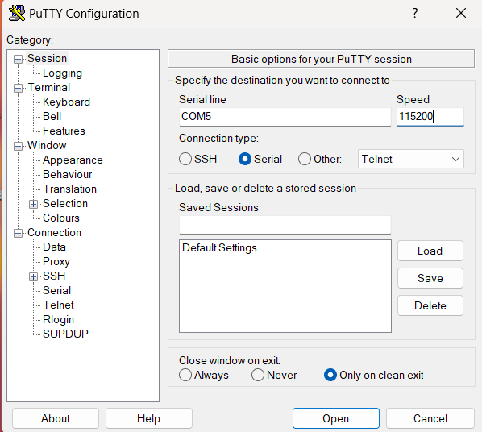
To display GPS data on your PC, since there isn’t a built-in serial monitor like Arduino’s IDE, you can use Putty. First, download and install Putty. Then, open Device Manager on your PC and expand the Ports (COM & LPT) section to find which COM port your STM32’s ST-Link debugger is connected to. Open Putty, select Serial as the connection type, enter the COM port number you found, and set the baud rate to 115200 (matching your uart2 configured through CubeIDE or main ). This setup allows you to view real-time GPS data output from your embedded system in a terminal window, making debugging and monitoring straightforward.

Slide 4
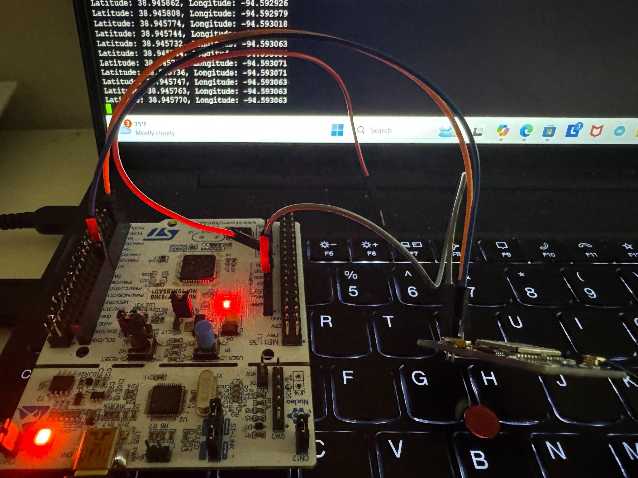
STM32 Receiving and Displaying GPS Data via UART

